Slide 1
Office Working/Home Sitting Posture Recognition with Computer Vision
Capstone
Nelson Agus Kesuma
DSI-28

Slide 2
01
Table of Contents
02
03
04
Introduction
Dataset & Exploratory Data Analysis
Modelling & Model Evaluation
Live Demo
05
Conclusions & Next Steps

Slide 3
01
Introduction

Slide 4

Understanding the Problem
DIGITAL INTERACTION
Increase in human-machine interaction
POSTURE RECOGNITION
WORK FROM HOME
WFH is more common in “new normal”
Growing needs for sitting posture recognition
Notes:
In this digital era nowadays when Information Technology is very booming and work from home is a very common thing in the “new normal”, there is an increase in digital interaction which is the human-machine interaction. Thus, when people work from home, there are different styles of workstations/designs, be it chair/table/monitor height. In a sense, it is not a standardised layout like what we have in offices. All these influences our sitting posture and as such, there is a growing needs for sitting posture recognition.

Slide 5

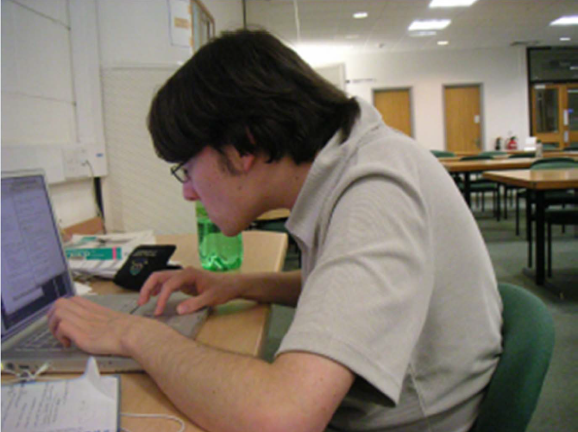




Postures
Notes:
So questions, how many of yall have this kind of postures during work? I bet most of yall have this kind of postures without yall even realising it. Or even this posture when yall hunch more forward subconsciously? Or even this posture when yall just try to sit or work anywhere yall want be it at living room, dining table, temporary table, etc. So all these are very very bad postures which is why probably yall crave to go JB massage or thai massage. So yeah all these are very common postures that we do without realising it.

Slide 6
Statistics At-a-Glance
One in four American adults spend more than eight hours a day sitting
On top of usual 9-5 hours, 43% of the US population use a computer for 2 hours per day or more.
This amounted to a minimum of 10 hours per day
A survey of 8,500 participants showed that 41% of chairs were set at wrong height (too low)
A survey of 8,500 participants showed that 51% of monitors were set at unoptimized height (too low)
Notes:
To give you guys the context, one in four American adults spend more than eight hours a day sitting. On top of usual 9-5 hours 43% of the US population use a computer for 2 hours per day or more. This amounted to a min of 10 hours per day. A survey of 8,500 participants showed that 41% chairs were set too low which cause your arms to not be in 90 degree or monitors were too low which is why yall slouch a lot.

Slide 7

Common Effects of Bad Sitting Posture
Spine Curvature
Disrupted Digestion
Headache
Back Pain
Poor Sleep
Neck Pain
Lack of motivation
Productivity Decrease
Notes:
These are just common effects of bad sitting posture which include spine curvature, disrupted digestion, poor sleep, headache, back pain, neck pain, lack of motivation and productivity decrease.

Slide 8
3.5 Billions per year
Healthcare cost estimation by Workplace Safety and Health (WSH) Singapore
Notes:
Workplace Safety and Health Singapore recently conducted a study and found out that healthcare cost due to poor ergonomics amounted to about 3.5 billions per year.

Slide 9
Propose to develop Computer Vision live posture classification
There are myriad cost and effects due to unmonitored bad sitting posture during work
Develop Machine Learning Model to accurately predict multiclass sitting posture classification
Evaluation Criteria:
High test accuracy score of above 90% on validation set
High F1-score of above 90% on validation set
Notes:
As such, myself as an AI developer from AI Singapore was tasked to develop a computer vision program to classify sitting postures. This could potentially helps your employees in managing bad postures and mitigate long term health effects. Also, this will be able to improve productivity.
For the evaluation criteria, we need to reach a high test accuracy score of 90% and above on validation set and a high F1-score of above 90% on validation set

Slide 10
02
Dataset & Exploratory Data Analysis
Notes:
Next, lets explore the dataset

Slide 11
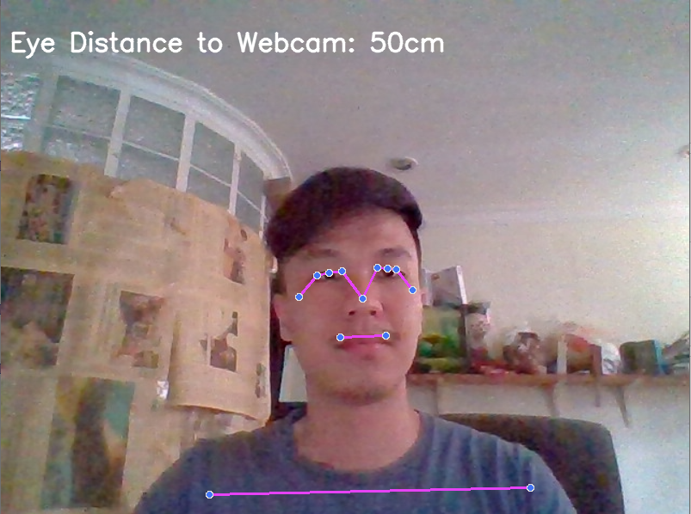
Initial Dataset Overview
Webcam
Taken ownself through webcam
Consist of 33 feature landmarks (xyz and v coordinates)
FEATURES
DESCRIPTION
133 columns
Posture
1720 rows
132 coordinates (4 * 33 landmarks)
Notes:
Dataset was separated to webcam and side cam. First we’ll explain for the webcam one. Since there is no dataset online on sitting postures, I took and recorded ownself through webcam and it consist of 33 feature landmarks (nose, right shoulder, left shoulder , left mouth point, right mouth point, etc) and there are coordinates (x,y,z that are normalised to the frame) and v coordinates for visibility. A total of 133 columns were extracted in the dataset

Slide 12
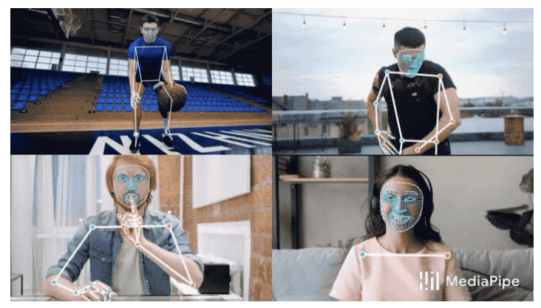
Tools to Get There
MediaPipe
Google Open Source framework
Accurate Pose Estimation for media processing
Cross-platform friendly. It runs on Android, iOS, web and Youtube servers
Combination of Face mesh, Pose classification, object detection, selfie segmentation etc.
Notes:
Mediapipe- it is a powerful google open source machine learning framework. It has good and accurate pose estimation for media processing like audio and video on youtube. It is also cross-platform friendly and runs on different Operation system like android, iOS, etc and it has a lot of solutions for face mesh, pose classification, object detection, selfie segmentation, etc.

Slide 13
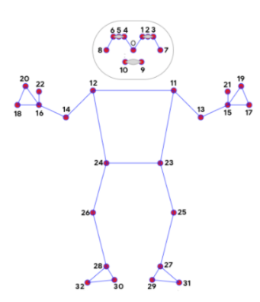

Tools to Get There
Notes:
First I recorded myself and the computer will extract all the key landmarks visible in the frame. Output will be some rendering on my webcam as shown

Slide 14
Extract & Export
Record Body Landmarks
Convert Landmarks to Coordinates
Export as CSV
Notes:
Afterwards , I do extraction through body landmarks recording, and convert those landmarks to coordinates and ultimately export as CSV.

Slide 15
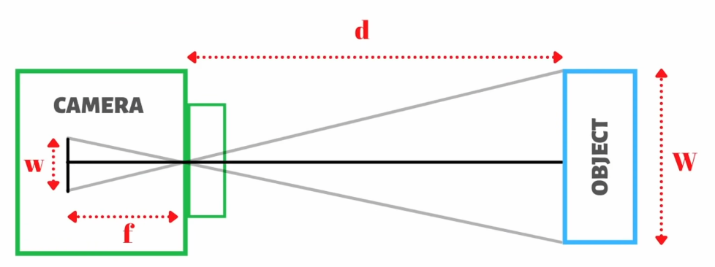
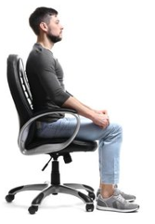
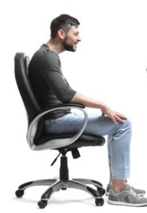
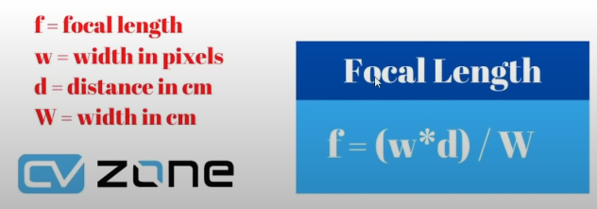
Feature Engineering
further
nearer
Eye Distance to Camera
Important to determine eye closeness to screen
When people slouch, their eyes are usually closer to the screen
Ideal distance to screen is usually one’s arm length
Notes:
I also did some feature engineering in which I try to add more accurate feature as the z coordinate in mediapipe is not as robust. In this case, I added eye distance to camera as it is important to determine eye closeness to the screen. When people slouch, their eyes are usually closer to the screen as well. Ideal distance to screen is usually one’s arm length

Slide 16
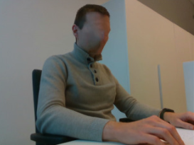
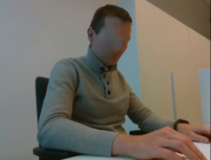
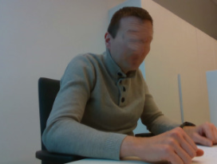
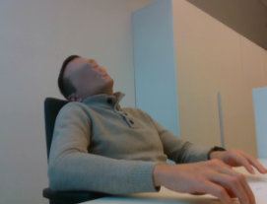

The Posture Classification
Straight
Slouched
Slouched + Roundshoulder
Lieback
Uneven shoulder

Slide 17
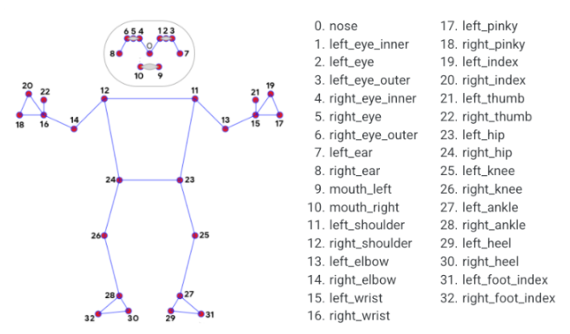
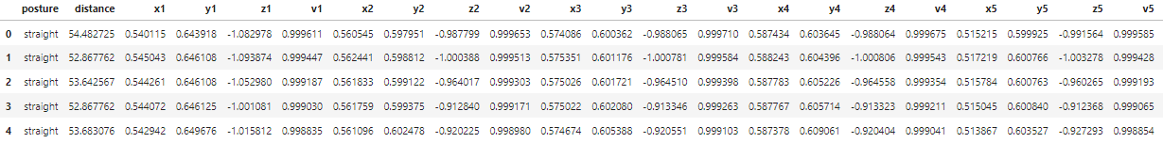
The Webcam Dataset
X1: x-coordinate of nose
Y1: y-coordinate of nose
Z1: z-coordinate of nose
V1: Likelihood of nose in the frame

Slide 18
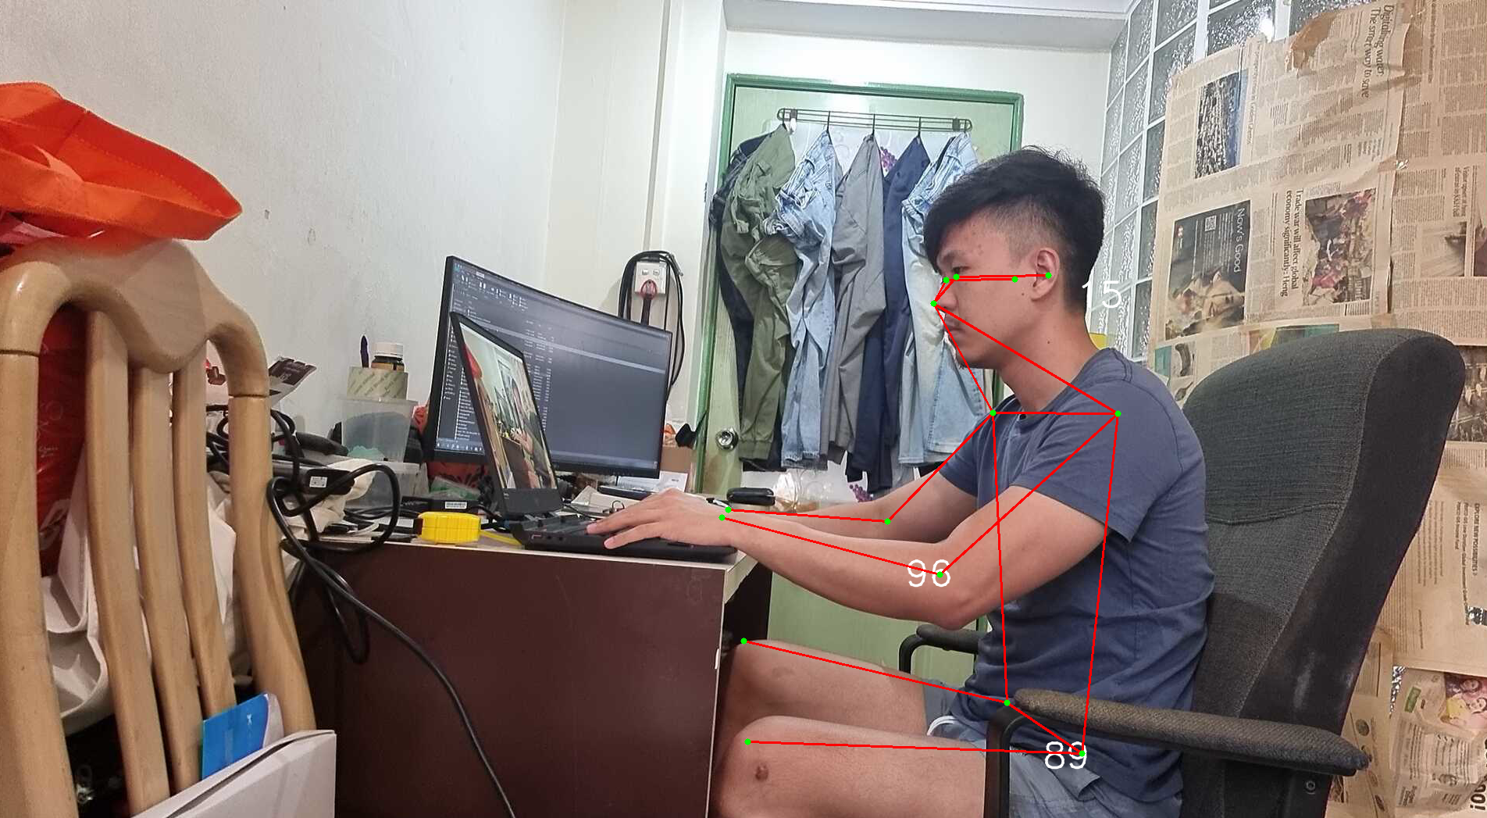
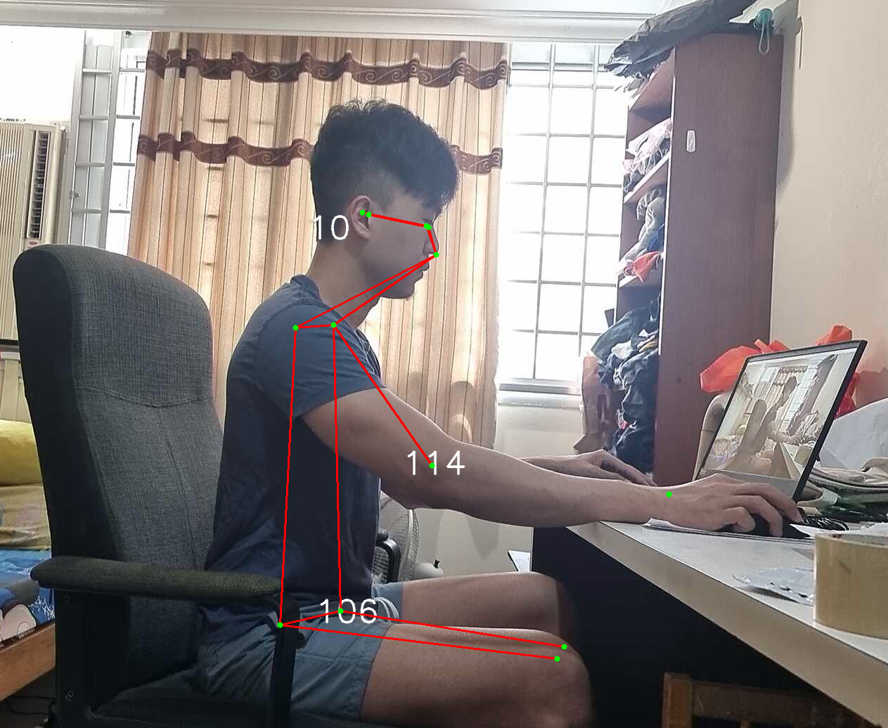
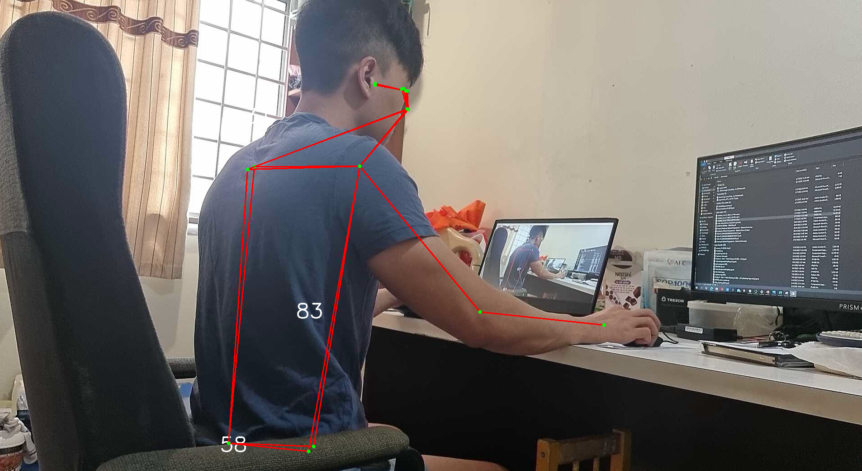
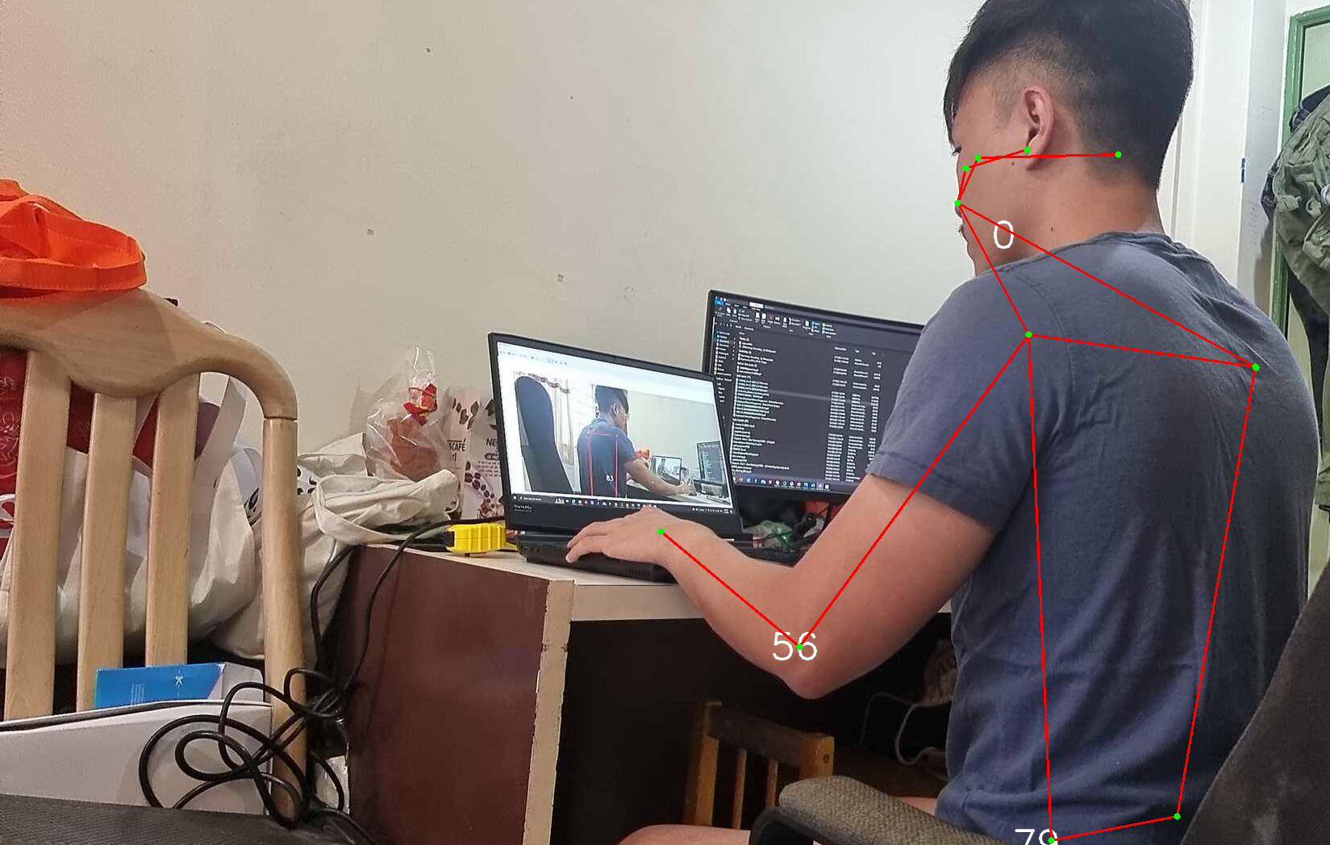
Initial Dataset Overview
Sidecam
Taken ownself through sidecam (left, right, diagonal right, diagonal left)
Consist of 17 feature landmarks (xy-coordinates and s)
FEATURES
DESCRIPTION
52 columns
5498 rows
Posture
51 coordinates (3 * 17 landmarks)

Slide 19
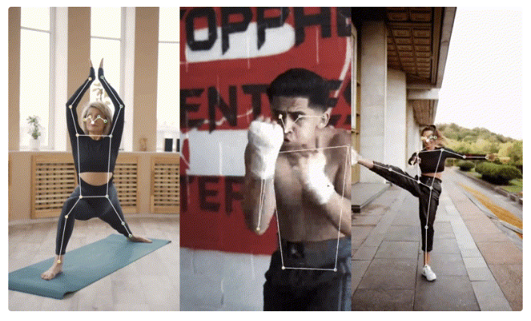
Tools to Get There
TensorFlow MoveNet
Google Open Source framework from Tensorflow
Latest release in 2021 of Accurate Pose Estimation for media processing library
Good prediction for covered joint areas

Slide 20
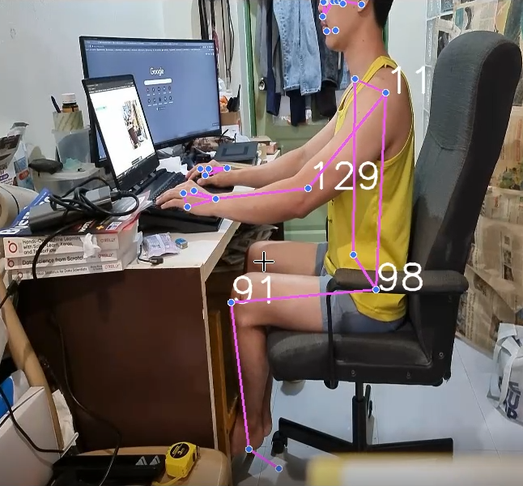
The Difference
MediaPipe
Tensorflow Movenet
MediaPipe requires an initial pose alignment and dataset to where either the whole person is visible or where hips and shoulders keypoints can be confidently annotated.

Slide 21
Feature Engineering
Neck Inclination
When people hunched, neck inclination angle is larger
Measured by using cross product of 2 vectors between shoulder (P1), ear (P2) and imaginary point (P3)
P3
P2
P1
Left Hip Angle, Left Bicep Angle, Right Hip Angle, Right Bicep Angle
Key angles for determining posture differences

Slide 22
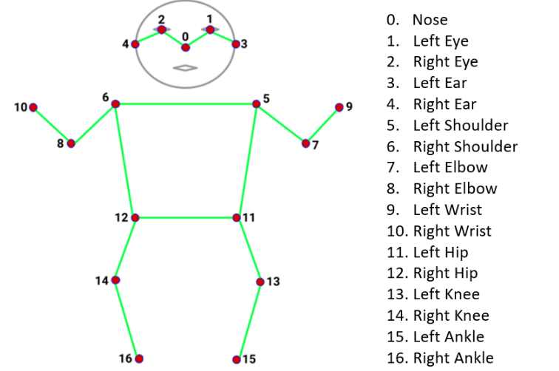
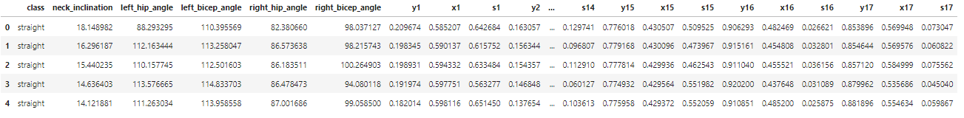
The Sidecam Dataset
X1: x-coordinate of nose
Y1: y-coordinate of nose
S1: Confidence score of nose in the frame

Slide 23
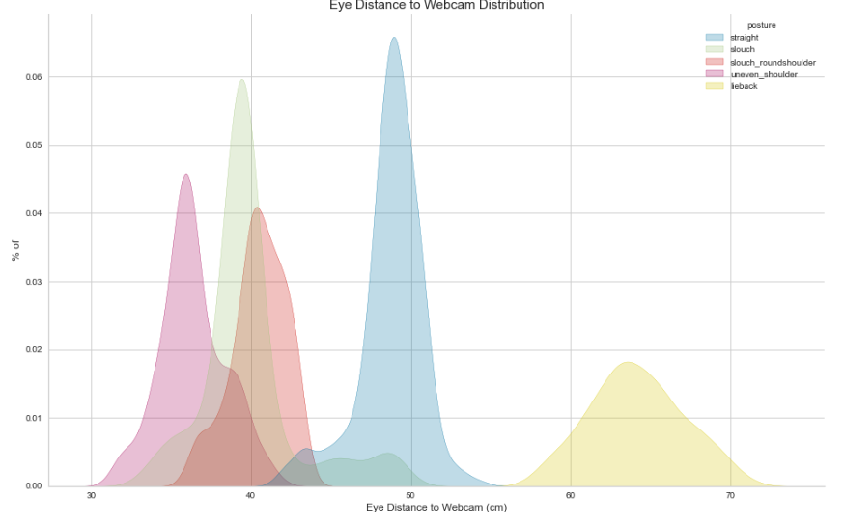
Eye closeness to screen distribution (Webcam)
Straight
Slouch
Slouched_roundshoulder
Uneven Shoulder
Lieback
Eye Distance to Webcam distribution differs from each posture
For straight posture, data is more distributed around 50cm which is the average human hand length. Thus, this is the correct sitting posture distance
For slouch, slouch_roundshoulder and uneven_shoulder, data centers around a closer distance to webcam
For lieback posture, eye distance to camera is usually further away from the webcam

Slide 24
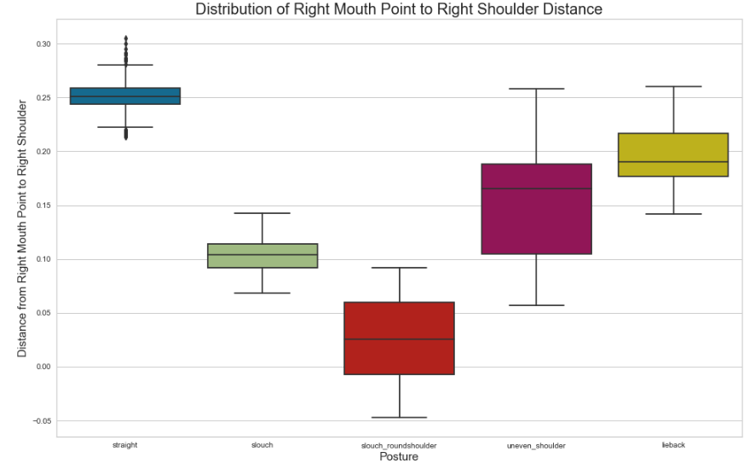
Mouth Distance to Shoulder by Postures (Webcam)
There is a trend observed from straight posture to slouch_roundshoulder posture. This is due to the nature of slouching in which the mouth is closer to shoulder and it is even closer when people have roundshoulder
For uneven shoulder and lieback posture, mouth closeness to shoulder is not as severe as slouching. However, noted that distance is still closer as compared to a straight posture

Slide 25
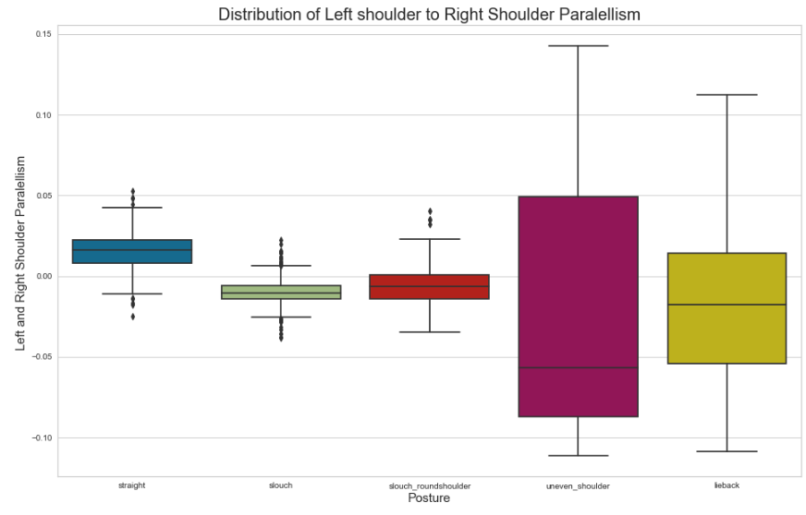
Shoulder Parallelism (Webcam)
For uneven shoulder, shoulder is indeed not parallel while other postures are relatively parallel

Slide 26
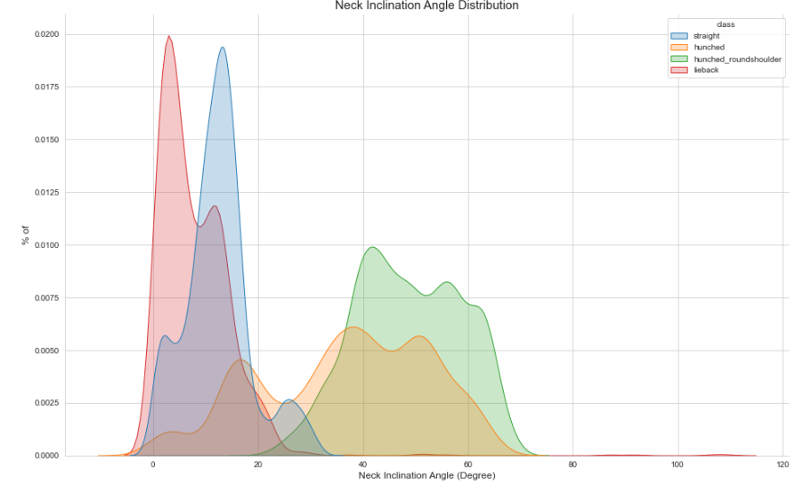
Neck Inclination Angle Distribution (Sidecam)
Straight
Hunched
Hunched_roundshoulder
Lieback
Straight and lieback posture neck inclination angle is the lowest
Hunched and hunched_roundshoulder postures have the largest neck inclination angle

Slide 27
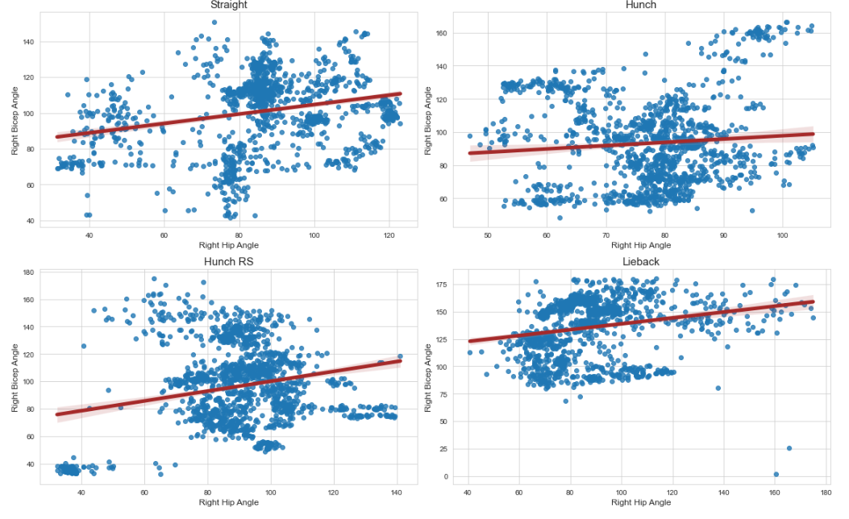
Arm and Torso Angle Correlation (Sidecam)
Generally all postures have similar correlation
Hunched_roundshoulder has datapoints trained at very low bicep angle and hip angle
Lieback has datapoints trained at higher bicep angle

Slide 28
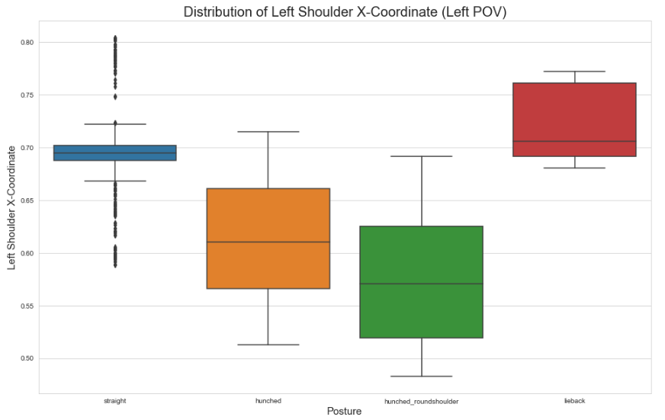
Shoulder relativity to frame (Left POV) (Sidecam)
Hunched_roundshoulder has a more forward shoulder than other posture

Slide 29
03
Modelling & Model Evaluation

Slide 30
Modelling
Logistic Regression
Random Forest Classifier
Fits data on a sigmoid curve to classify 2 categories
Ensemble of decision trees to vote on the predicted class. Predicted class is decided through majority outcome from each decision tree
Ridge Classifier
Adaptive Boosting Classifier (ADA)
Similar to ridge regression, only converts target data into [-1,1] and solve with ridge regression method
Combines weak classifiers into a strong classifier by learning through mistakes
Gradient Boosting Classifier
Decision Tree Classifier
Combines weak classifiers into a strong classifier by taking a subset of data in each iteration and learning through mistakes
Single Decision tree outcome prediction

Slide 31
Modelling
Webcam
Models | Validation Accuracy | Mean F1 Score of 5 Postures
Logistic Regression | 99.8% | 99.8%
Ridge Classification | 97.2% | 97.2%
Random Forest Classifier | 99.6% | 99.6%
Gradient Boosting Classifier | 99.6% | 99.5%
Adaptive Boosting (ADA) Classifier | 53.2% | 45.1%
Decision Tree Classifier | 98.6% | 98.6%
Logistic Regression, Random Forest and Gradient Boosting Classifier have relatively high validation accuracy score and F1 score

Slide 32
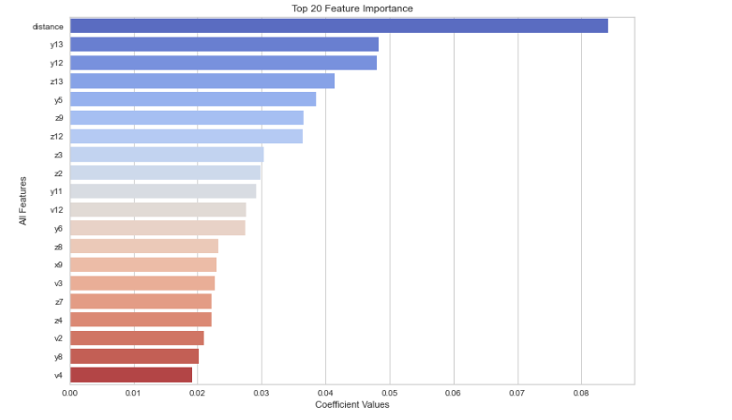
Feature importance to classify a posture (Webcam)
Distance
Y-Right shoulder
Y-Left shoulder
Z-Right shoulder
Y-Right eye outer
Z-Right ear
Z-Left Shoulder
Z-Left Eye
Z-Left Eye inner
Y-Mouth Right
Above is the top 3 key predictors for the model to classify a posture:
Distance
y13 (Right Shoulder)
y12 (Left Shoulder)

Slide 33
Modelling
Sidecam
Models | Validation Accuracy | Mean F1 Score of 5 Postures
Logistic Regression | 98.8% | 98.8%
Ridge Classification | 95.2% | 94.5%
Random Forest Classifier | 99.6% | 99.1%
Gradient Boosting Classifier | 99.5% | 99%
Adaptive Boosting (ADA) Classifier | 59.4% | 57.7%
Decision Tree Classifier | 97.4% | 97%
Logistic Regression, Random Forest and Gradient Boosting Classifier have relatively high validation accuracy score and F1 score

Slide 34
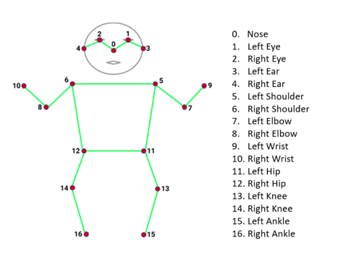
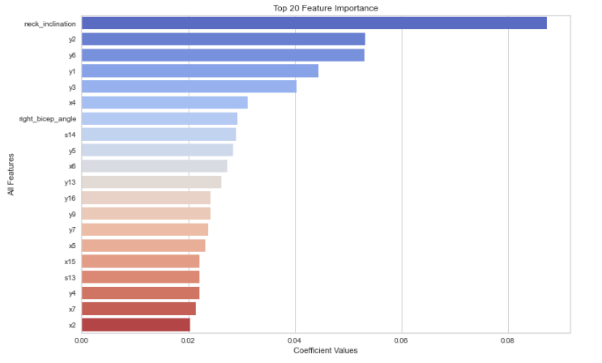
Feature importance to classify a posture (Sidecam)
Neck_inclination
Y-Left Eye
Y-Left shoulder
Y-Nose
Y-Right Eye
X-Left Ear
Right bicep angle
S-Left Knee
Y-Right Ear
X-Left Shoulder
Above is the top 3 key predictors for the model to classify a posture:
- Neck inclination
- y2 (Left Eye)
- Y6 (Left Shoulder)

Slide 35
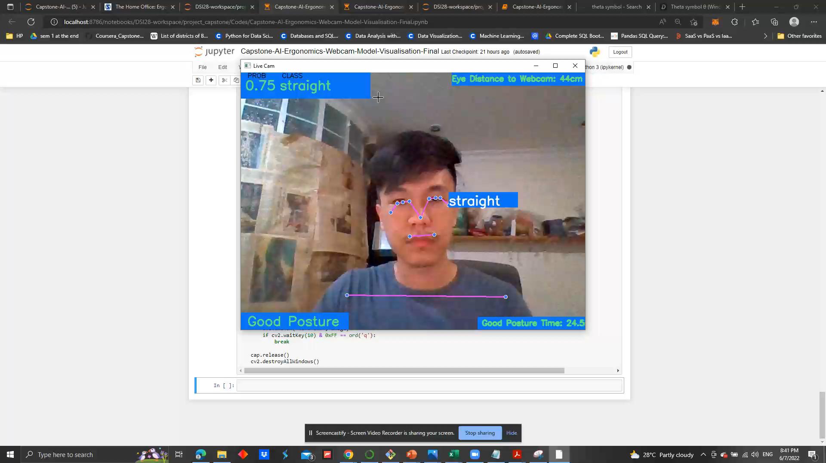
Webcam Video Prediction

Slide 36
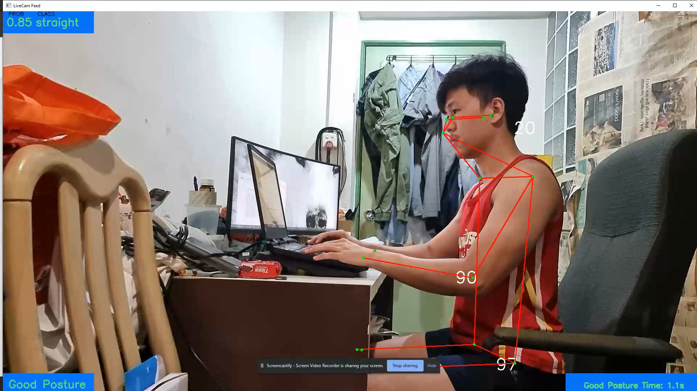
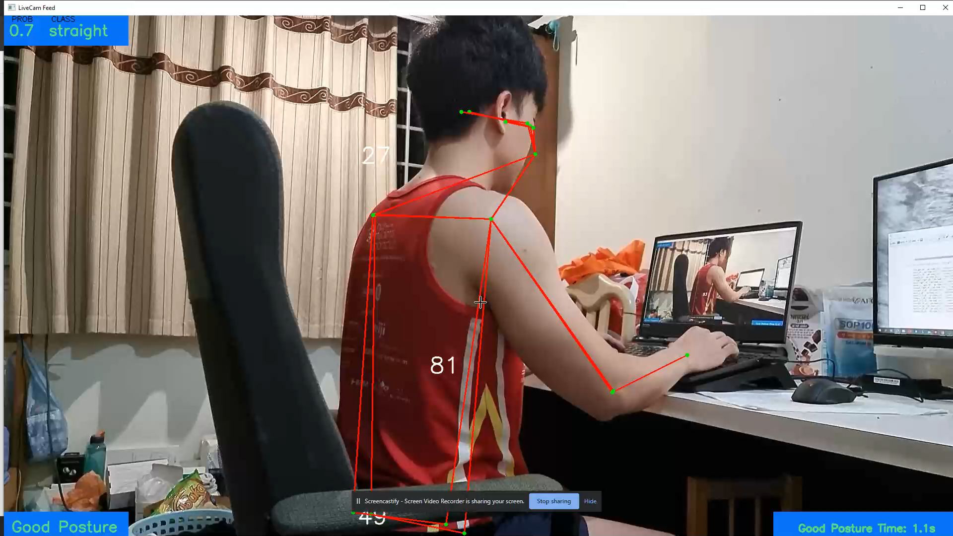
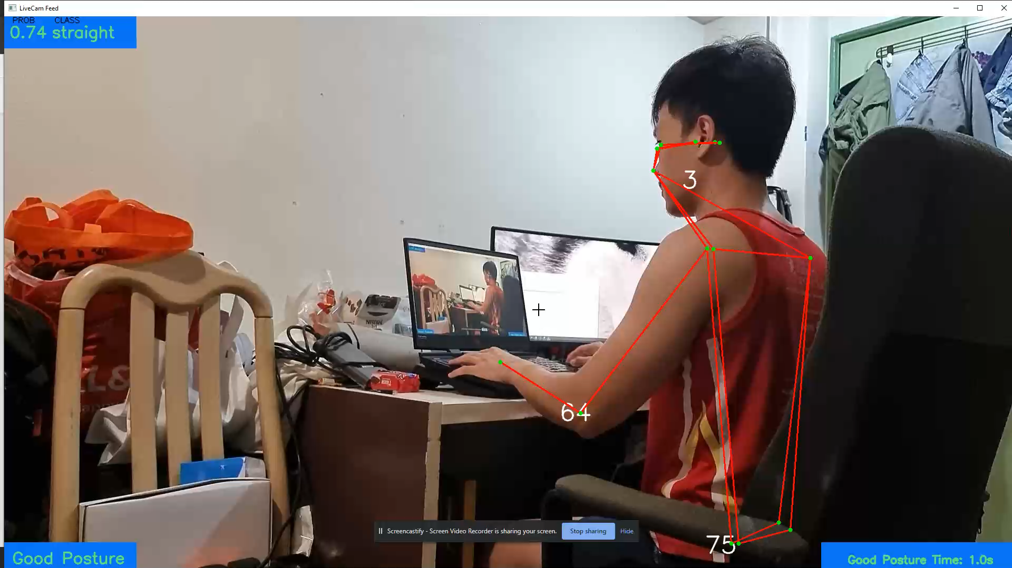
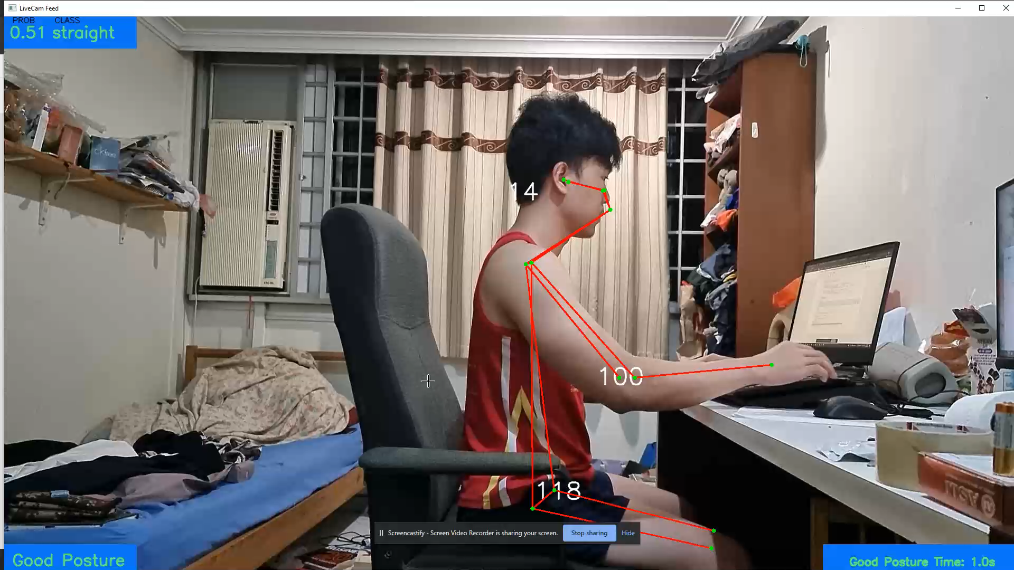
Sidecam Video Prediction

Slide 37
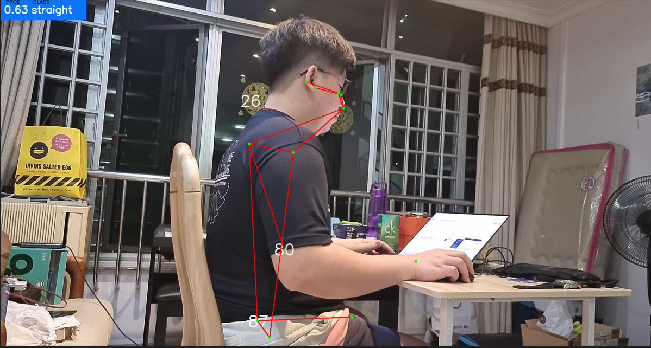
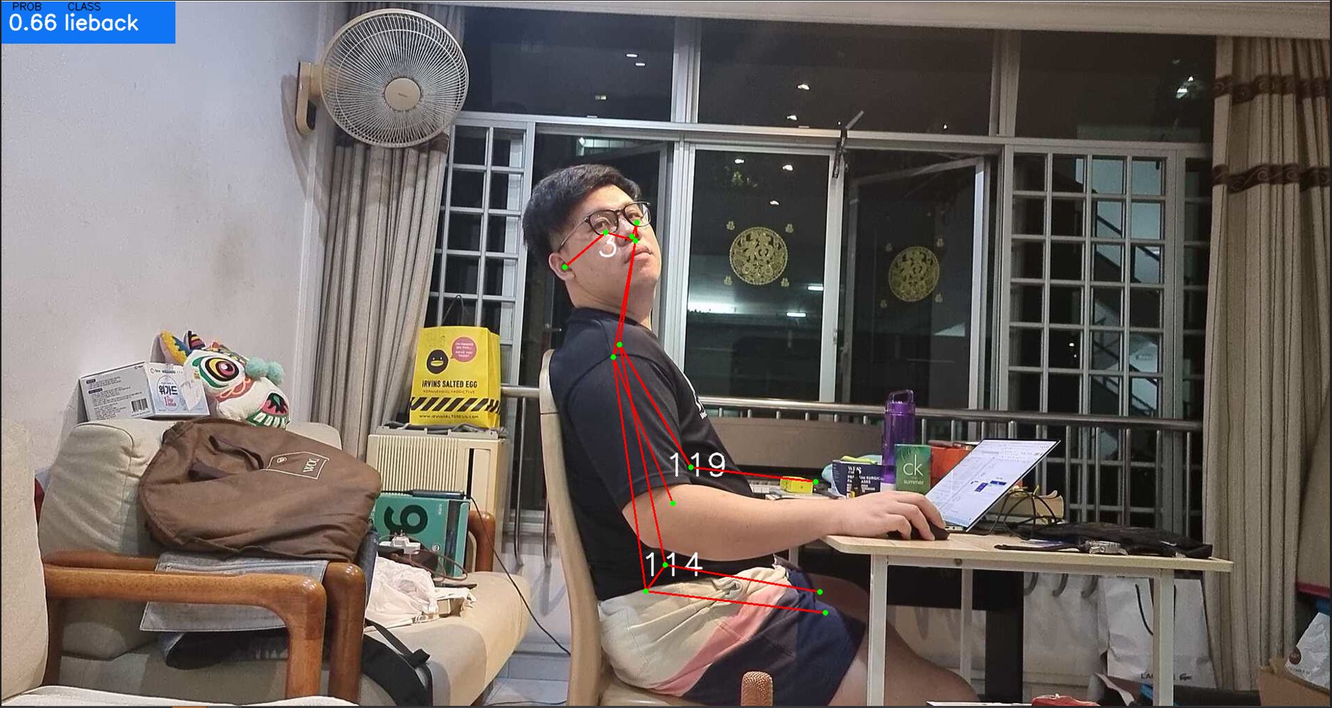
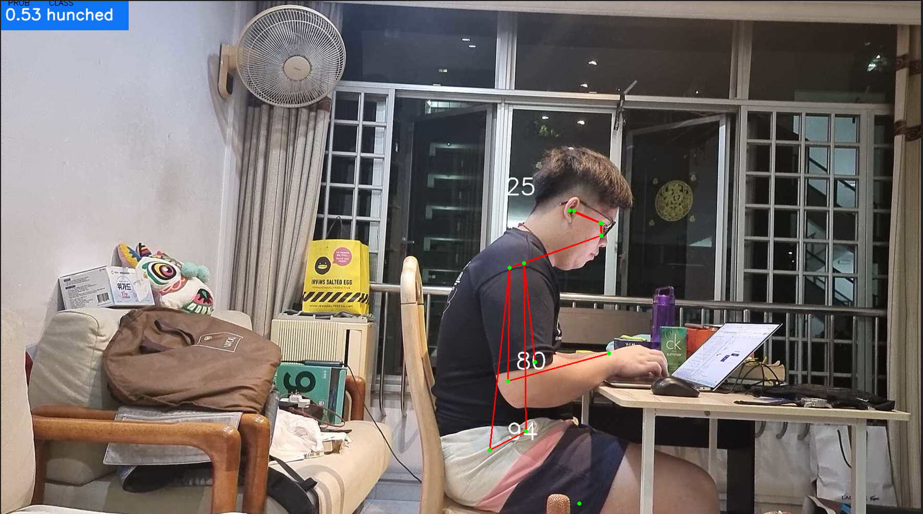
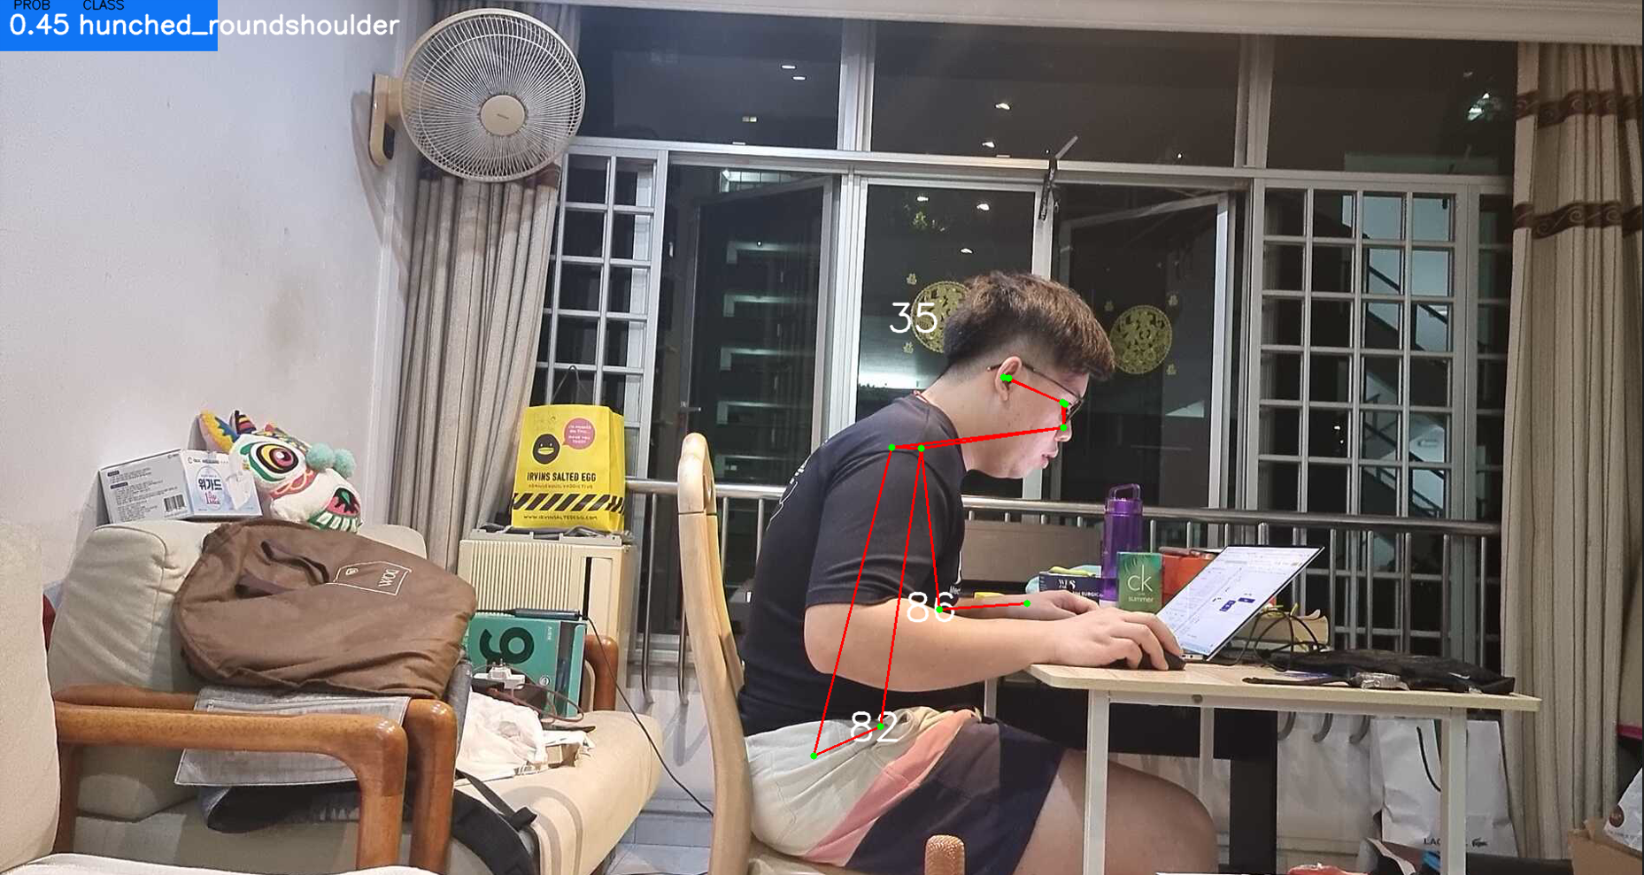
Sidecam Video Prediction

Slide 38
04
Live Demo

Slide 39
05
Conclusions & Next Steps

Slide 40
Conclusions
Best Model: Random Forest Classifier
Achieved 99.6% validation score on both webcam & side cam
Achieved ~99% F1 score on both webcam & side cam
Computer Vision Live Prediction score can be further enhanced with more training datasets through different camera angles and camera placements
However, model is able to capture postures relatively well and are able to capture landmarks & features

Slide 41
Challenges/Limitations
Models are only able to predict straight, slouched/hunched, slouched/hunched + roundshoulder, uneven shoulder and lieback.
In real life, there are other postures affecting ergonomics (cross legs, butterfly sit posture, knee angle detection, etc)
Models are too sensitive to camera angle and placements. Thus, moving the camera to train improved the computer vision accuracy. However, more coverage area is needed for training.

Slide 42
Next Steps
More complex postures specifically legs joints as these body parts also affect sitting ergonomics.
Utilize more cameras to cover all camera angles/placements for model training. Thus, it will be able to create a much robust model at different placements when deployed to offices/homes.
Train more models to cater for 2 or more people in a frame.
Explore deep learning models (CNN or RNN) for possibly improve predictive power.
Use of object detection models such as Mask R-CNN or YOLO to detect monitors, chairs and tables to ultimately give recommendations for best alignments/placements and heights for each workstation.
Use Tkinter to develop GUI app for posture record and recommendations to correct postures.

Slide 43
Thanks!
Do you have any questions?
Please keep this slide for attribution

Slide 44
Appendix

Slide 45
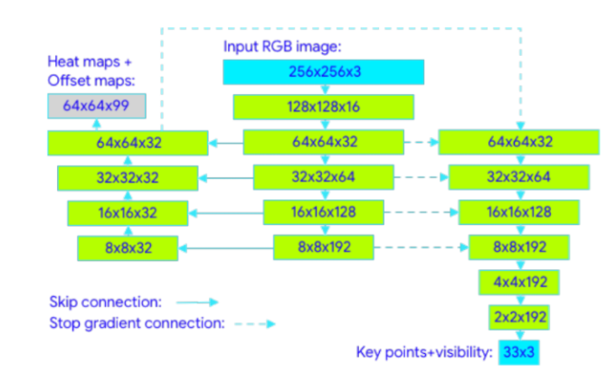
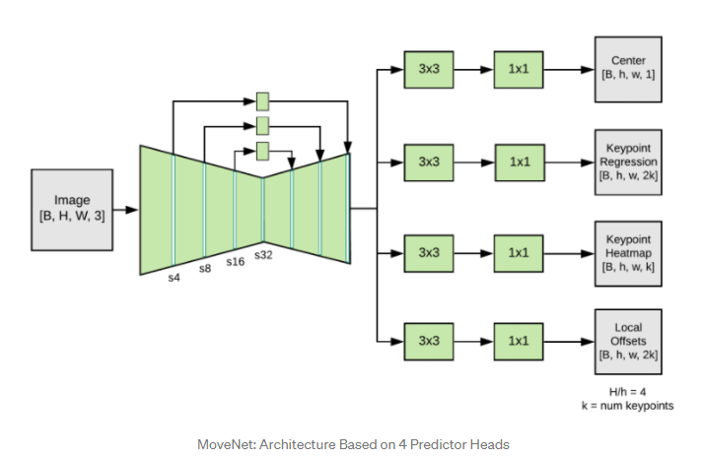
MediaPipe vs MoveNet
MediaPipe
MoveNet
Top-Down Models
Bottom-Up Models
Notes:
https://maureentkt.medium.com/selecting-your-2d-real-time-pose-estimation-models-7d0777bf935f

Slide 46
MediaPipe vs MoveNet
MediaPipe
MoveNet
The input to the model is 256X256X3 which gets reduced to 8X8X192 through a bunch of convolution blocks then the encoder output is upsampled along with skip connections.
The output of the encoder-decoder is 64X64X32 which is passed to the coordinate regression network and another convolution layer that produces heatmap and offset map of output 64X64X99. Since there are 33 key points we can say for every keypoint it predicts 3 images. Coordinate regression network predicts the key points and visibility of key points. The network itself has backpropagation but has a stop gradient connection with the encoder. Intuitively, we can say that the coordinate regression network has no control over the encoder and decoder but leverages its information for predicting keypoints. The output of the Coordinate regression network is 33X3 which is for each keypoints we have x_coordinate, y_coordinate, and visibility.
Four prediction heads are attached to the feature extractor:
1. Person center heatmap to predict geometric center of person instances
2. Keypoint regression field to predict full set of keypoints for a person to group keypoints into instances.
3. Person keypoint heatmap to predict location of all keypoints irrespective of person instances
4. 2D per-keypoint offset field to predict local offsets from each output feature map pixel to the precise sub-pixel location of each keypoint.
Notes:
https://maureentkt.medium.com/selecting-your-2d-real-time-pose-estimation-models-7d0777bf935f

Slide 47
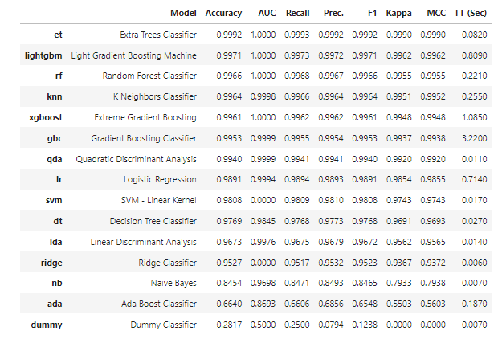
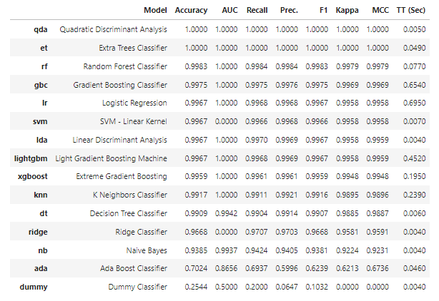
PyCaret Model
Webcam
Sidecam

Slide 48
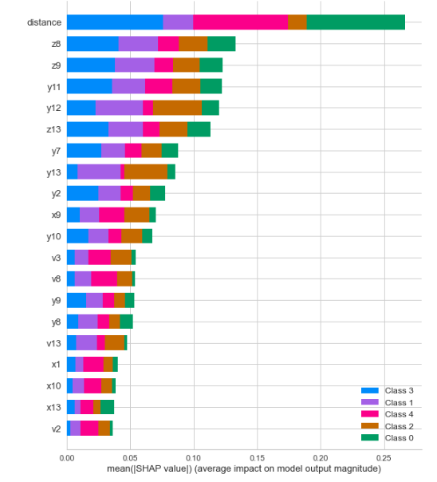
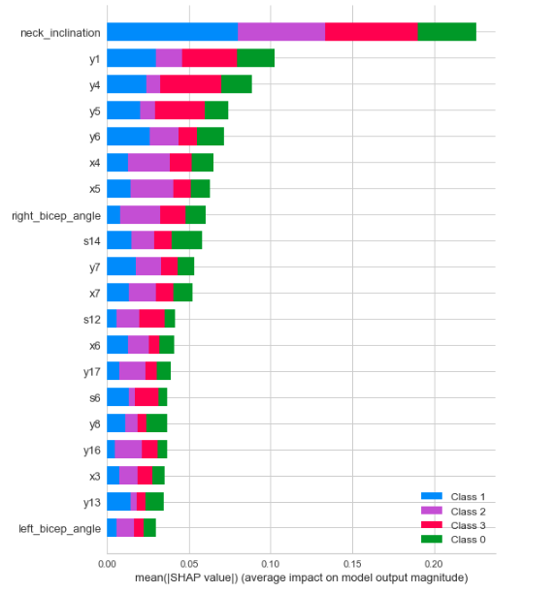
PyCaret Model
Webcam (extra trees classifier)
Sidecam (extra trees classifier)

Slide 49
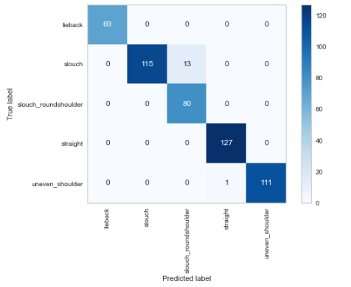
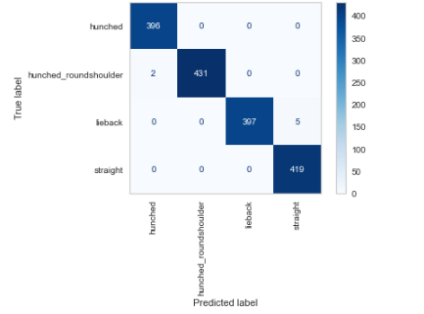
Confusion matrix (Random Forest)
Webcam
Sidecam

